Slide 1
The C Programming language (based on earlier slides by Dag Langmyhr and Michael Welzl)
C is the programming language for IN2140
This course introduces operating systems and networks.
Why can’t we use Python?
Many things that an operating system must do cannot be done in Python at all.
Operating systems require attention to detail. Python is excellent for getting results quickly without bothering with details.
Why can’t we use Rust?
It is possible to perform critical operations close to the hardware.
Learning how to bypass Rust’s safety to do it takes a lot of time.

Slide 2
The C Programming language
Invented by Dennis Ritchie
for the implementation of the Unix operating system at AT&T’s Palo Alto laboratory 1960-75
Well-known variants:
K&R C (Kernighan and Ritchie’s C, the original)
ANSI C (also called C89)
C99
C11
GNU11 ← the one we use in IN2140

Slide 3
What is C good for?
Write large software packages

Slide 4
What is C good for?
Write large software packages
Write programs with a low memory footprint
Write programs with low computation time
Accessing and controlling the hardware resources of a computer
Use the architecture-dependent features of a computer
Learn to understand how memory is used, manipulated and managed

Slide 5
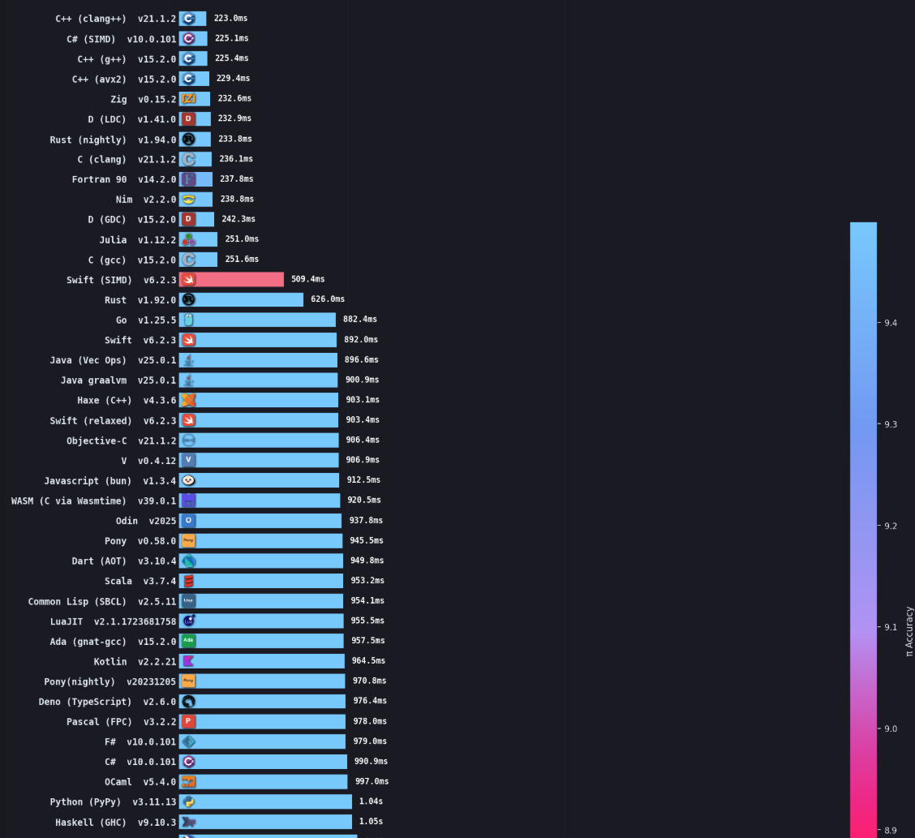
Programs that run fast
https://niklas-heer.github.io/speed-comparison/
Rust
C
Important to keep in mind: these measurement are from heavy computing in these languages
Python

Slide 6
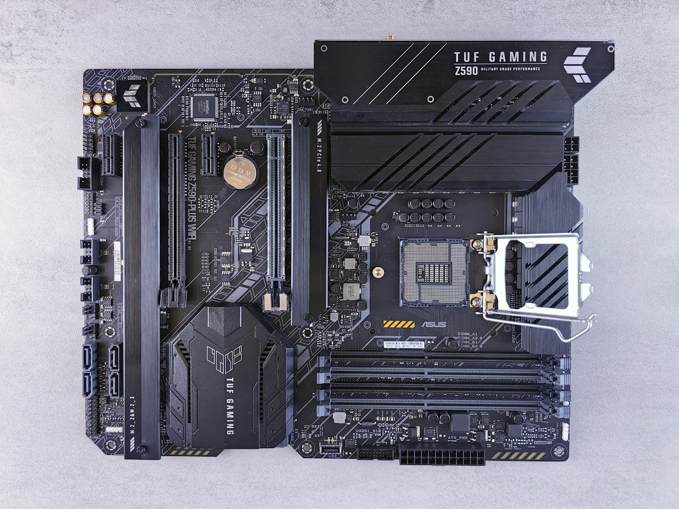
Locating a few hardware pieces
up to
3x NVMe (non-volatile memory express) disks
go here
BIOS
and more
other things (incl network)
CPU
goes here
up to
4x RAM
banks
go here
maybe another
GPU?
GPU
does probably go here
by Andrey Matveev (free to use)

Slide 7
The CPU must control all of this
0x0000000000000000
BIOS Data
BIOS/UEFI reserved
RAM
more RAM
could be more PCIe devices, network, other disks, audio, ...
NVMe disk command and completion queue
NVMe controller registers
could be even more PCIe devices
GPU command queue
GPU control registers (BAR), PCIe MMIO
0xFFFFFFFFFFFFFFFF
smallest possible 64bit address
each of these resource has
a unique block of
Addresses
largest possible 64bit address

Slide 8
The CPU must control all of this
0x0000000000000000
BIOS Data
BIOS/UEFI reserved
some RAM used by the operating system kernel itself
more RAM
could be more PCIe devices, network, other disks, audio, ...
NVMe disk command and completion queue
NVMe controller registers
could be even more PCIe devices
GPU command queue
GPU control registers (BAR), PCIe MMIO
0xFFFFFFFFFFFFFFFF

Slide 9
The real power of C: memory manipulation
0x0000000000000000
BIOS Data
BIOS/UEFI reserved
DMA buffers for Device I/O
Kernel dynamic memory
Kernel page table
Kernel code & data
RAM
Process 1 data
Process 2 data
Process 3 data
more unused RAM
space for more PCIe devices (addresses without physical memory)
NVMe disk command and completion queue
NVMe controller registers
more PCIe devices
GPU command queue
GPU control registers (BAR), PCIe MMIO
lots of addresses that don’t have any physical memory
0xFFFFFFFFFFFFFFFF
Operating systems must be capable of making changes everywhere

Slide 10
The real power of C: memory manipulation
0x0000000000000000
BIOS Data
BIOS/UEFI reserved
DMA buffers for Device I/O
Kernel dynamic memory
Kernel page table
Kernel code & data
RAM
Process 1 data
Process 2 data
Process 3 data
more unused RAM
space for more PCIe devices (addresses without physical memory)
NVMe disk command and completion queue
NVMe controller registers
more PCIe devices
GPU command queue
GPU control registers (BAR), PCIe MMIO
lots of addresses that don’t have any physical memory
0xFFFFFFFFFFFFFFFF
send commands to a disk, listen to responses

Slide 11
The real power of C: memory manipulation
0x0000000000000000
BIOS Data
BIOS/UEFI reserved
DMA buffers for Device I/O
Kernel dynamic memory
Kernel page table
Kernel code & data
RAM
Process 1 data
Process 2 data
Process 3 data
more unused RAM
space for more PCIe devices (addresses without physical memory)
NVMe disk command and completion queue
NVMe controller registers
more PCIe devices
GPU command queue
GPU control registers (BAR), PCIe MMIO
lots of addresses that don’t have any physical memory
0xFFFFFFFFFFFFFFFF
start a new process (think of a process as an instance of a program)

Slide 12
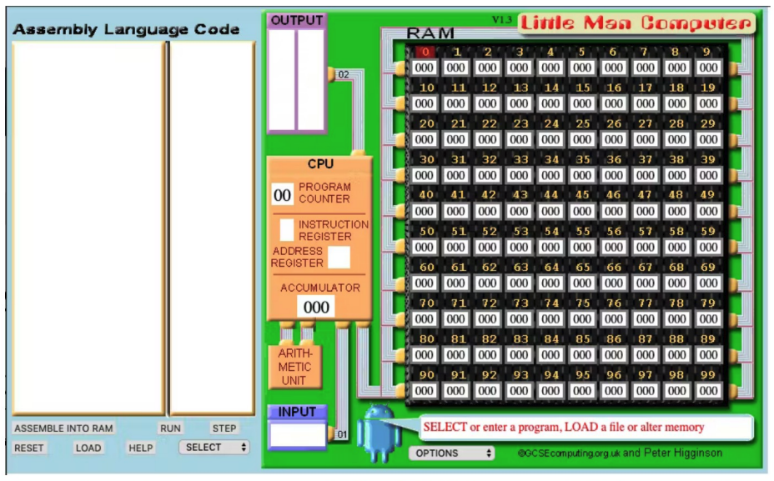
The real power of C: memory manipulation

Slide 13
C – pros and cons
Advantages
Compiles to really fast code
Well-standardized
Disadvantages
No built-in error handling
Code is not inherently portable
Both
Freedom ... do what you want but don’t expect help

Slide 14
Hello World
All teaching books start with an example like this:
#include <stdio.h>
int main(void)
{
printf("Hello 2140!\n");
return 0;
}
(Actually, Kernighan & Ritchie’s first book started this fashion)
Getting to the IFI Linux machine login.ifi.uio.no:
ssh -Y -J griff@login.uio.no griff@login.ifi.uio.no

Slide 15
What does it all mean?
C functions are similar to Python functions, but their specifications include more details.
parameter list
return type
#include <stdio.h>
int main(void)
{
printf("Hello 2140!\n");
return 0;
}
name
body

Slide 16
What does it all mean?
#include – same job as import but much more primitive
It does literally mean copy the content of stdio.h into this file before translating it to machine language.
#include <stdio.h>
int main(void)
{
printf("Hello 2140!\n");
return 0;
}
Files are included because they can contain, among other things, the declarations of functions the libraries provide to us.
Like here: printf – one of the standard output functions.

Slide 17
What does it all mean?
printf - a function that prints text into your terminal.
It can do a lot more than just printing a string. But first things first.
#include <stdio.h>
int main(void)
{
printf("Hello 2140!\n");
return 0;
}
"Hello 2140!\n"
This is a C-string. Much more primitive than a Python string.
How many bytes of space does it take up?

Slide 18
What does it all mean?
printf - a function that prints text into your terminal.
It can do a lot more than just printing a string. But first things first.
#include <stdio.h>
int main(void)
{
printf("Hello 2140!\n");
return 0;
}
Important!
We will get back to this
"Hello 2140!\n"
This is a C-string. Much more primitive than a Python string.
How many bytes of space does it take up? → who guessed 13?
One for every character in Hello 2140! -> 11
One for the newline character \n -> 1
One for a hidden 0-byte as end-of-string marker -> 1

Slide 19
What does it all mean?
main
a standalone C program starts with the function that is named main
#include <stdio.h>
int main(void)
{
printf("Hello 2140!\n");
return 0;
}
int return 0;
It says that the program returns an integer (int) value when it ends. Terminals expect 0 for no error and negative values for errors. Positive values are sometimes computation results.

Slide 20
Compilation
To translate the program into runnable machine instructions, use:
$ gcc -o hello hello.c
This can now be executed without an interpreter (without the huge hidden Python machinery)
$ ./hello

Slide 21
Makefile
It can be tedious to type this every time you made a change. make helps. Write a file called Makefile.
target
dependencies
rules
hello: hello.c
gcc –o hello hello.c
$ make
If any dependency has changed since the creation of target, make a new target using the rules.

Slide 22
Makefile
If you want to type less (but remember more):
target
dependencies
hello: hello.c
gcc –o $@ $^
$ make

Slide 23
Functions
Functions must be declared before use:
#include <stdio.h>
void printme()
{
printf("Hello 2140!\n");
}
int main(void)
{
printme();
return 0;
}

Slide 24
Functions
Not possible:
Possible:
#include <stdio.h>
int main(void)
{
printme();
return 0;
}
void printme()
{
printf("Hello 2140!\n");
}
#include <stdio.h>
void printme();
int main(void)
{
printme();
return 0;
}
void printme()
{
printf("Hello 2140!\n");
}

Slide 25
Functions
Modular programming is very important
hello.c
out.c
#include "out.h"
int main(void)
{
printme();
return 0;
}
#include <stdio.h>
void printme()
{
printf("Hello 2140!\n");
}
Makefile
out.h
hello: hello.c out.c
gcc –o $@ $^
hello: out.h
#ifndef OUT_H
#define OUT_H
void printme();
#endif

